Slide 1

Altium Designer – Introduction

Slide 2
Altium Designer Introduction
On the Schedule
Review Resources – Altium, PCB Fab, Other Free PCB ECAD packages
Altium ECAD Package Breakdown
Example Project
Competition

Slide 3
Altium Designer Introduction
Resources
Altium Resources:
Design Content - https://designcontent.live.altium.com/#UnifiedComponents
Video Guides - https://altiumvideos.live.altium.com/#Index/0/0
Installed Examples - C:\Users\Public\Documents\Altium\AD17\Examples
PCB Manufacturing Resources:
PCB - http://www.4pcb.com
PCB - http://www.sunstone.com/
Stencils - https://www.oshstencils.com/#
PCB Assy - https://macrofab.com/
Component Suppliers:
Digikey – https://www.digikey.com/
Mouser – http://www.mouser.com/
Free PCB Design Tools:
https://circuitmaker.com/#why_circuitmaker
http://www.4pcb.com/free-pcb-layout-software/
https://www.sunstone.com/pcb-products/pcb123

Slide 4
Altium Designer Introduction
Unified ECAD System
Schematic Symbols and PCB Footprints (Libraries)
Schematic Capture
PCB Layout
Fabrication Documentation

Slide 5
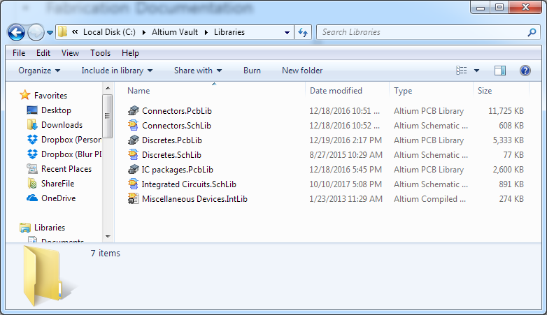
Altium Designer Introduction
Example Project – Getting Started
Setup master library and project folder under root (Location doesn’t really matter. I like to minimize the path.)
Install the libraries:

Slide 6
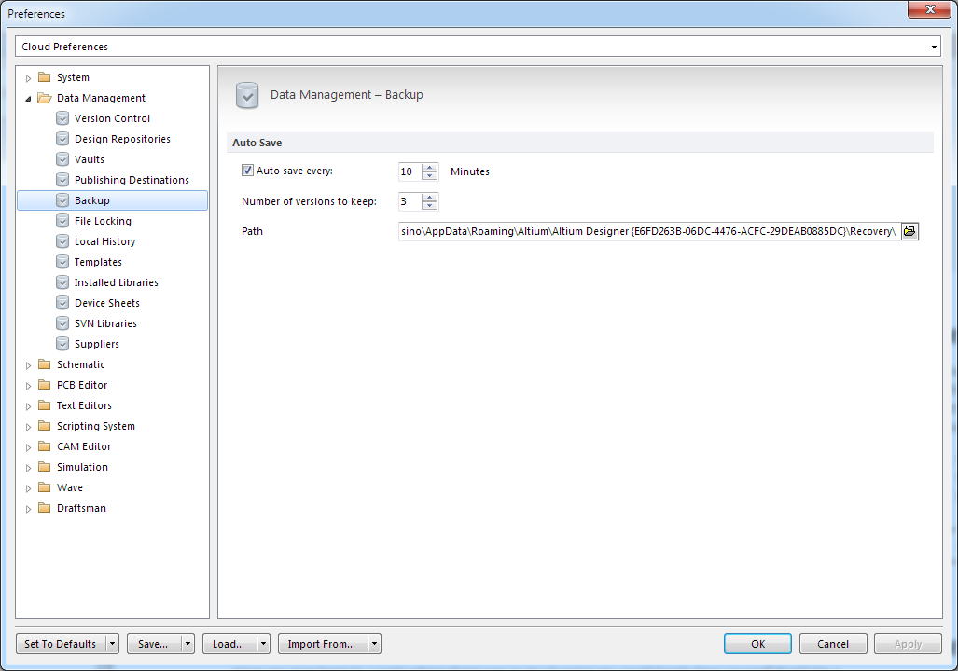
Altium Designer Introduction
Example Project – Getting Started
Altium Preferences

Slide 7
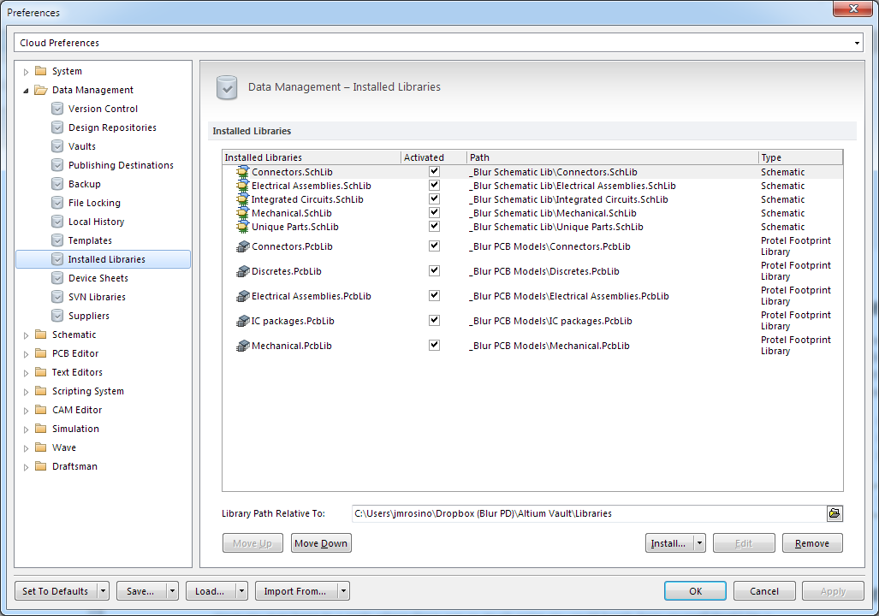
Altium Designer Introduction
Example Project – Getting Started
Setup Altium to find libraries:

Slide 8
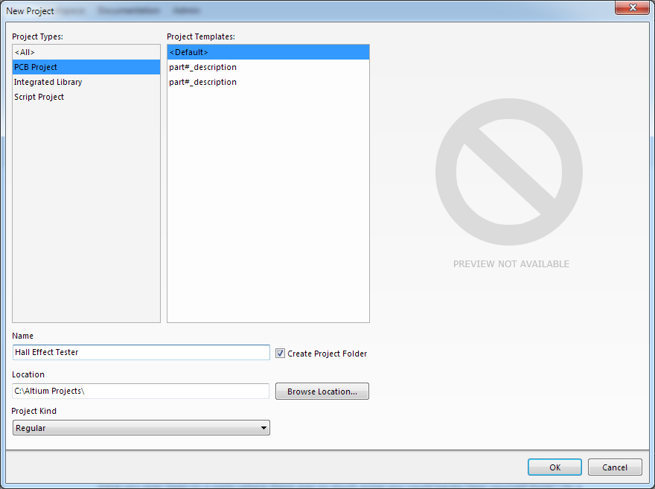
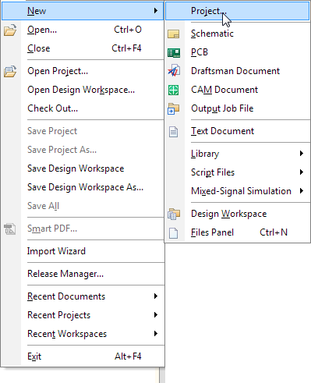
Altium Designer Introduction
Example Project – Hall Effect Sensor Magnet Tester
Start a new project:

Slide 9
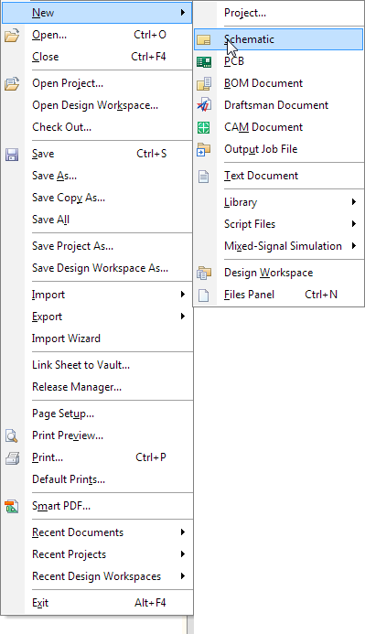
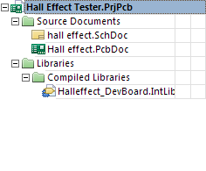
Altium Designer Introduction
Example Project – Hall Effect Sensor Magnet Tester
Add Schematic, PCB Objects, and Integrated Library (by add existing)

Slide 10
Altium Designer Introduction
Example Project – Hall Effect Sensor Magnet Tester
Design Requirements
Hall Effect Sensors/switch must be placed 1 inch apart along the Y axis edge and centered.
Board size - “C” shaped: 1.0”x1.5” with 0.5”x0.4” notch in center.
When magnet is in range, LED illuminates (active high).
Run on 3.3V rail.

Slide 11
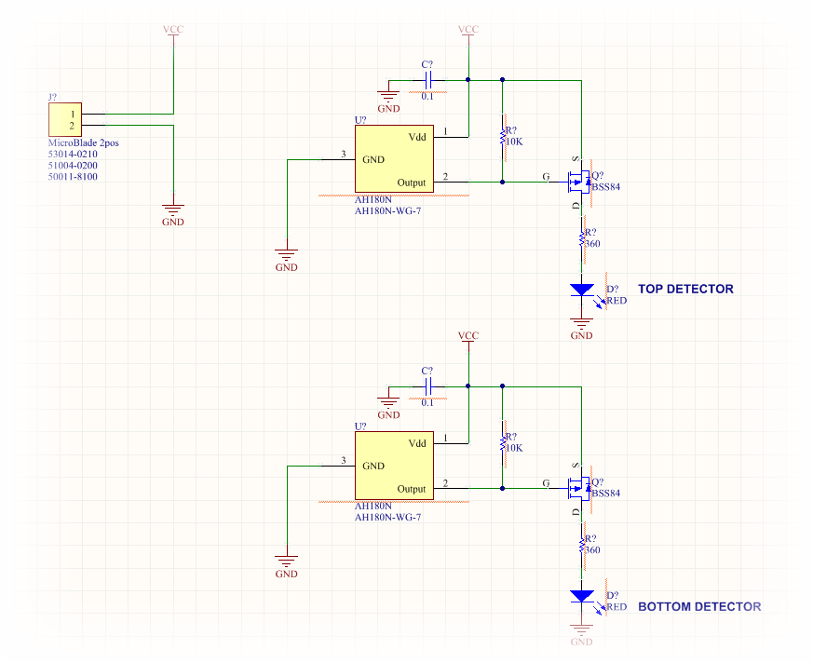
Altium Designer Introduction
Example Project – Hall Effect Sensor Magnet Tester
Save Project and Start Capturing

Slide 12
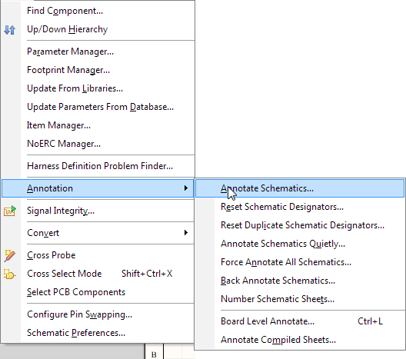
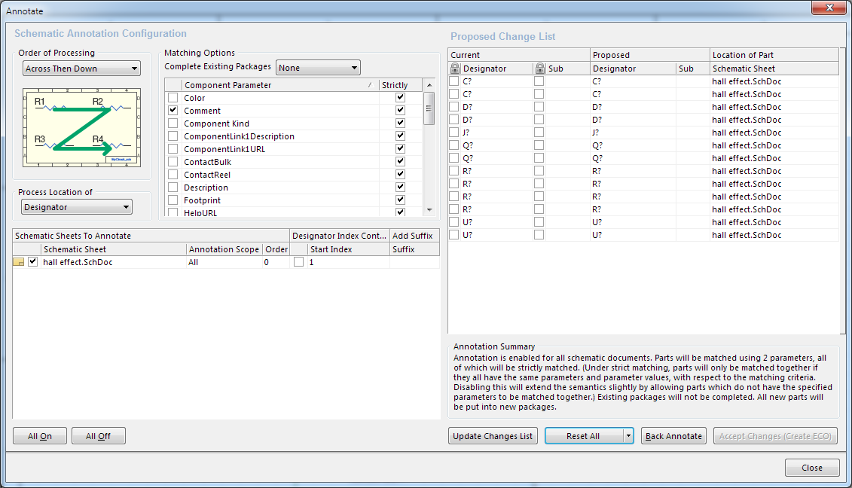
Altium Designer Introduction
Example Project – Hall Effect Sensor Magnet Tester
Annotate Schematics and Compile Design – Providing a unique designator to each component

Slide 13
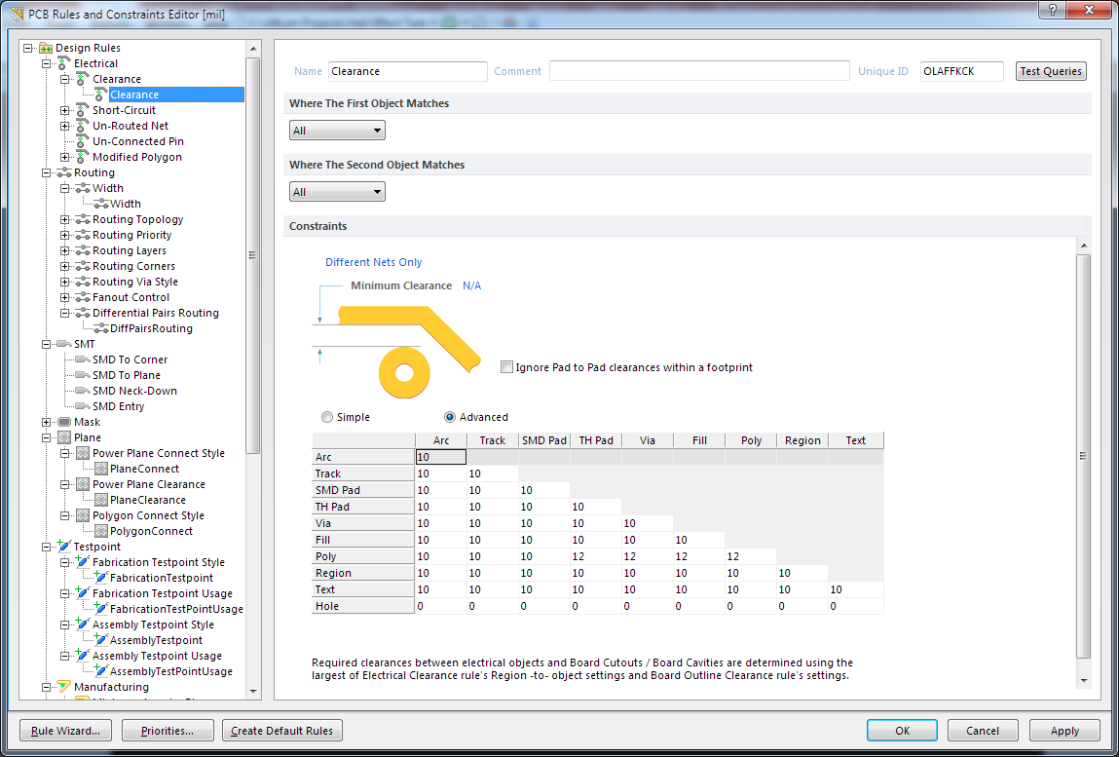
Altium Designer Introduction
Example Project – Hall Effect Sensor Magnet Tester
PCB Design Time – First need to setup design rules

Slide 14
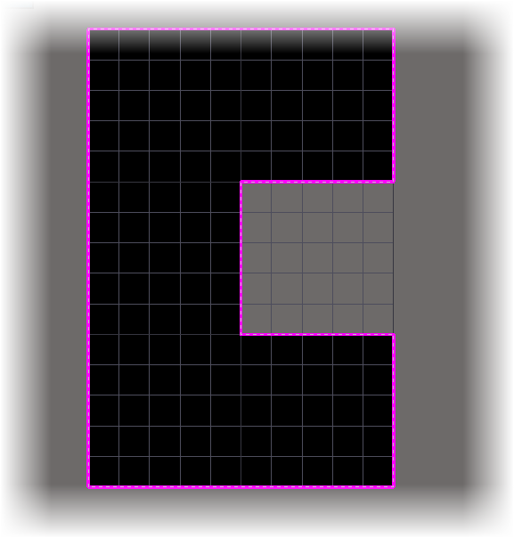
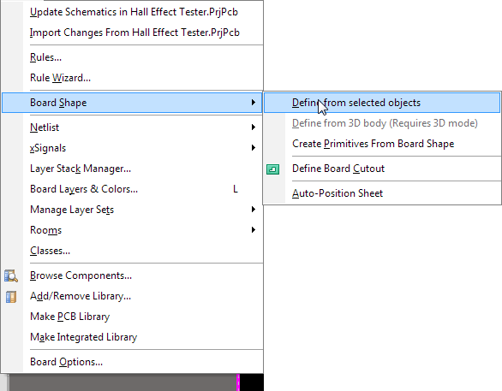
Altium Designer Introduction
Example Project – Hall Effect Sensor Magnet Tester
PCB Design Time – Setup PCB outline
Tips – Space bar changes end angle. Shift +Space Bar changes line type. Tab during command lets you edit style.

Slide 15
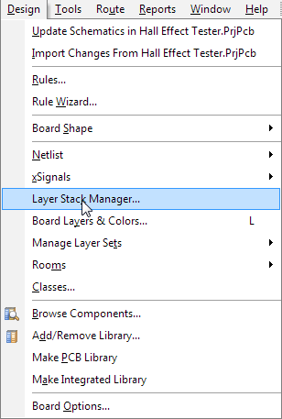
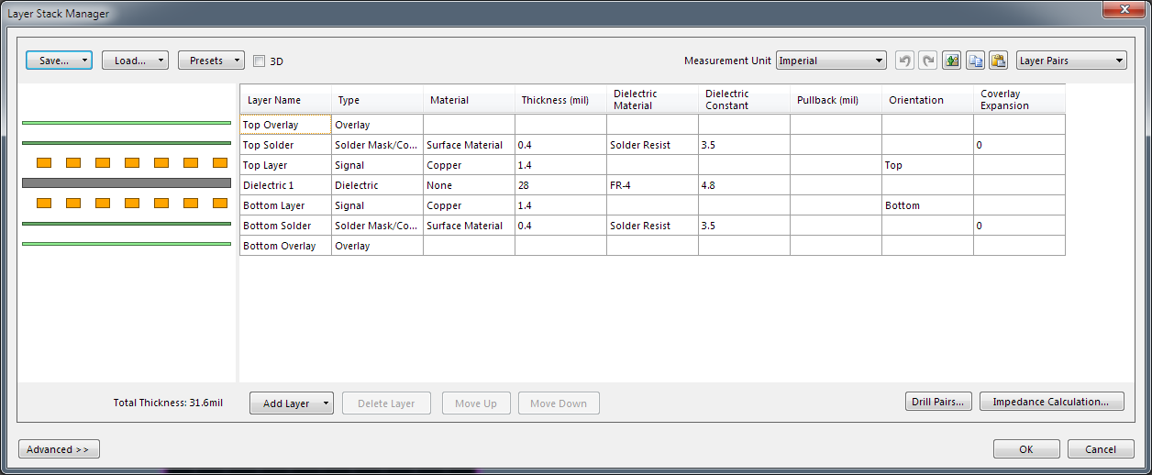
Altium Designer Introduction
Example Project – Hall Effect Sensor Magnet Tester
PCB Design Time – Define Layer Stack

Slide 16
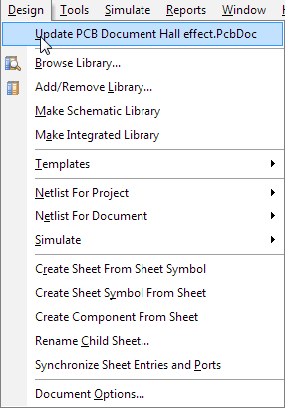
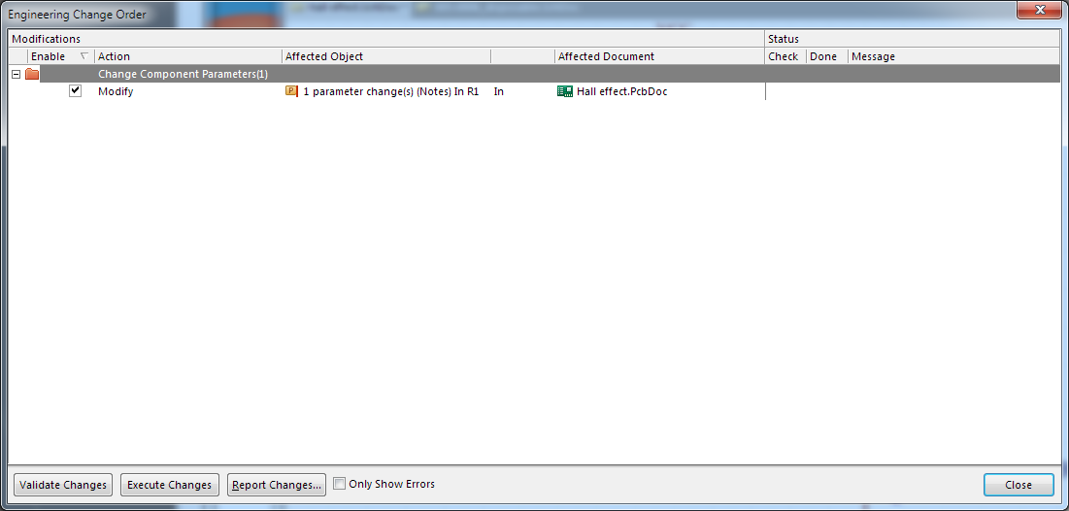
Altium Designer Introduction
Example Project – Hall Effect Sensor Magnet Tester
Update PCB Design – From the schematic page, click “Update PCB Document…”

Slide 17
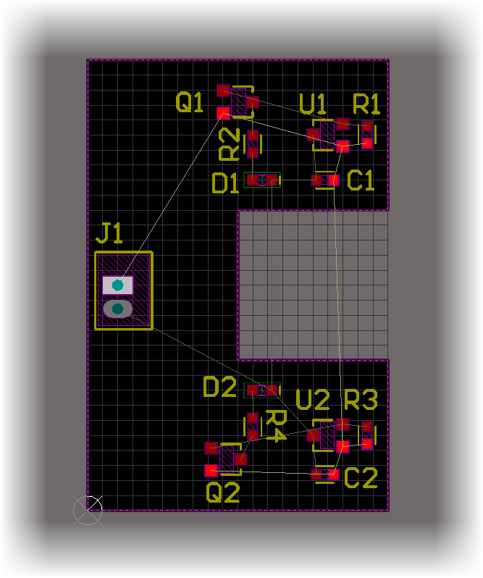
Altium Designer Introduction
Example Project – Hall Effect Sensor Magnet Tester
PCB Design Time – Layout (Place Components)
Tips – Press “M” then “C” to move component. Make sure to select “Component jump to cursor”.

Slide 18
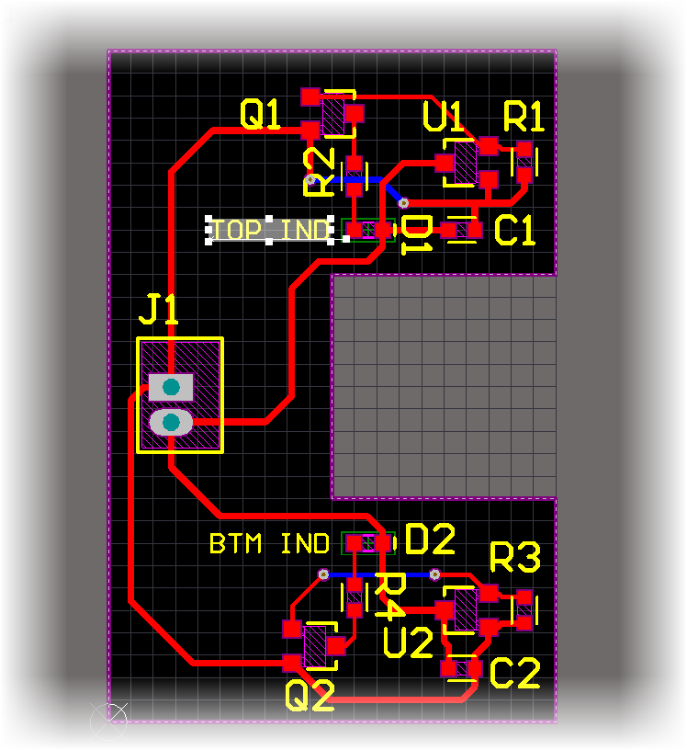
Altium Designer Introduction
Example Project – Hall Effect Sensor Magnet Tester
PCB Design Time – Route… not auto
Rules – No 90 deg bends. Hit center of pads. 15mil wide trace for power (3.3 and GND). All other nets can be 10mil.
Tips – Press TAB to change properties of a route. Use SHIFT + E to enable/disable hot snaps.

Slide 19
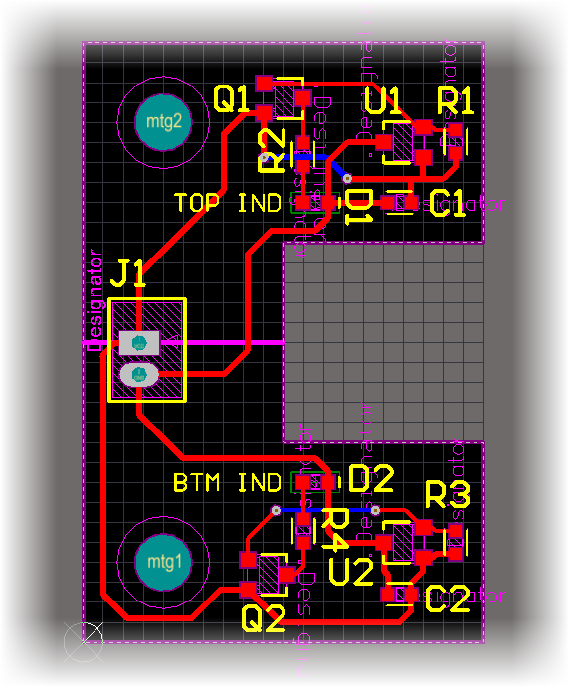
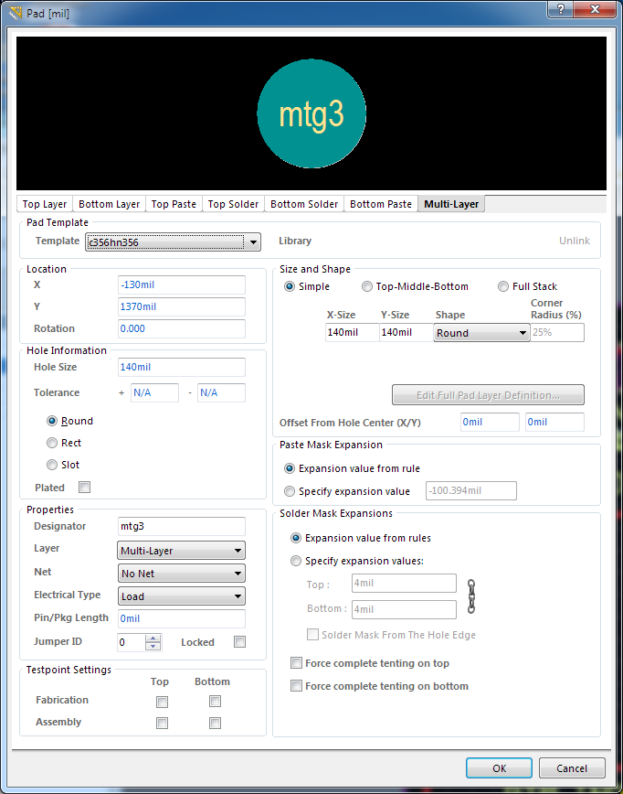
Altium Designer Introduction
Example Project – Hall Effect Sensor Magnet Tester
PCB Design Time – Add Mounting holes: #6 fastener -> 0.140”dia non plated. Place x 0.2 inch from left side top and bottom. Need screw head clearance of 0.230”

Slide 20
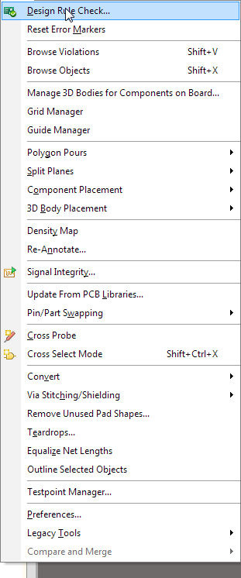
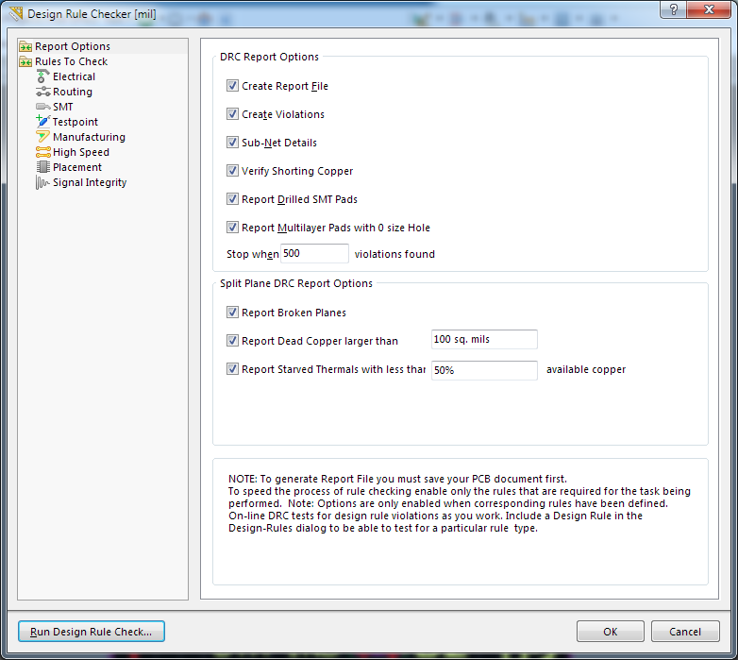
Altium Designer Introduction
Example Project – Hall Effect Sensor Magnet Tester
PCB Design Time – Design rule check

Slide 21
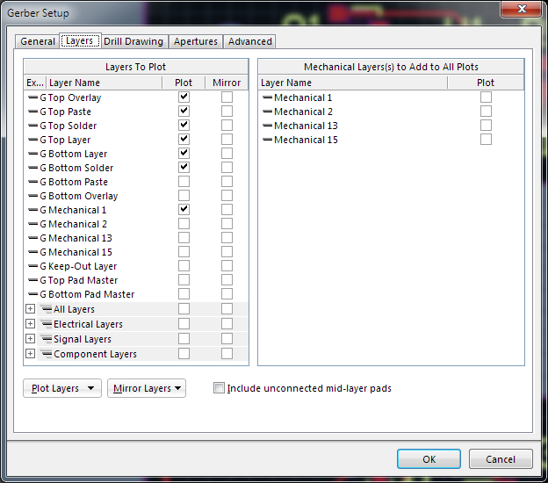
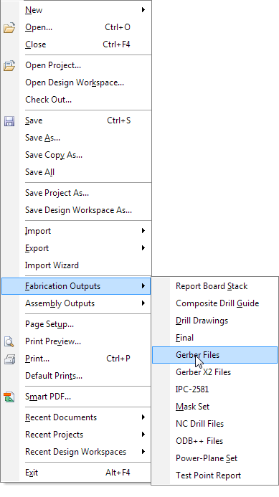
Altium Designer Introduction
Example Project – Hall Effect Sensor Magnet Tester
Fabrication Outputs (Using Advanced Circuits for PCB Fab).
Gerbers and drills

Slide 22
Altium Designer Introduction
Competition Time
Update design by adding two more hall effect sensor positions on the right side. Separate sensors by 0.5” and add in an EEPROM to identify the board. Need a separate connector to interface with the EEPROM.
Objective – Design for cost efficiency.
Cost of PCB - $1.00/SQIN
VIAs - $0.25 ea
Spacing – 10/10 no adder; 8/8 add $0.12 per net.

